Slide 1


Online Assessment
Strategies and Models
Survey
August – September
2003
15 Victoria Avenue,
Albert Park, Victoria 3206 AUSTRALIA
Ph: +61 3 9645 5516
Fx: +61 3 9645 5517

Slide 2
Contents
Objectives page 1
Methodology page 2
Key Findings pages 3-5
Profile Information pages 6-11
Involvement in Online Learning & Assessment pages 12-23
Approaches to Online Assessment pages 24-33
Issues & Benefits of Online Assessment pages 34-46

Slide 3
Objectives
Objective:
The Online Assessment Strategies and Models Survey was commissioned as a component of the Online Assessment Strategies and Models project. The project consortium incudes TAFE frontiers, Swinburne TAFE, South West TAFE and AMES.
The project is part of the Resources for Teaching, Learning and Assessment Program, an initiative of the Australian Flexible Learning Framework.
The overriding objective of the survey was to provide a snapshot of online assessment practice in vocational education and training (VET).
Data collected included:
Profile information in relation to role, industry, workplace type, industry and location;
Involvement in Online Assessment activities incorporating time spent, types of involvement, tasks undertaken, ways of working and resources used;
Approaches to Online Assessment related to purpose, types of outcomes, strategies employed and tools used;
Issues and Benefits of Online Assessment such as problems and advantages and general feedback.
The survey findings are to be used by the project team as input for the preparation of a new Web-based guide to assessing online with a range of practical tools for designers, developers, teachers, managers and support staff in VET. The guide will be available in January 2004.
page 1

Slide 4
Methodology
Methodology:
The survey questionnaire was developed by the project team incorporating feedback from the the Australian Flexible Learning Framework. It comprised both quantitative and qualitative elements to provide a robust data set.
On online survey was chosen as the data collection method. Melbourne based research firm, smi was engaged to undertake the programming, hosting, analysis and top line reporting.
The survey was hosted on a closed domain and was open over four weeks in late August and early September 2003.
A multi-source participant recruitment strategy was employed to provide comprehensive national coverage. This included relevant websites (flexiblelearning.net.au, TAFE VC, TAFE frontiers, EdNA) and newsletters (hyperlink, The Networker, Framework Loop).
An inventive to undertake the survey was offered, with the participant providing the best ‘tip’ for Online Assessment to be awarded a Digital camera.
page 2

Slide 5
Key Findings
A sample size of 158 respondents was achieved.
This extremely robust sample provides excellent data coverage and validates the choice of recruitment approach.
Key Findings
The participant profile was diverse indicating the widespread interest in online assessment:
  Teachers were the most represented cohort of the sample set, with over 4 in 10 participants to the survey.
  The majority of survey participants were from the TAFE sector, representing 2/3rds of the total sample set.
  While nearly ¼ of the survey participants were from general Education, a wide cross section of teaching areas were represented in the data set.
  All states and territories were represented in the geographic composition of the survey. Victorian based individuals had the strongest participation rate, comprising over 40% of the total sample.
Overall participation in the development and use of Flexible Learning Toolboxes was driven mainly by Teachers and Developers:
  Nearly 70% of sample respondents indicated that they had not participated in the development of a Flexible Learning Toolbox.
  Over 40% of the sample indicated that they had used a Flexible Learning Toolbox for delivery.
The majority of the sample set (81.6% overall) indicated that they had been involved in delivering and/or designing competency-based training using national training packages at some time.
Participants current time allocation on online learning activities was mixed:
  Nearly 30% of respondents indicated they spent less than ten percent of their workload engaged in online learning, and over 6 in 10 of the sample spend 50% or less of their time on online learning tasks.
  There was a minority of the sample who spent greater that 75% of their workload on online learning tasks, with Content writers and Programmers most likely to be engaged at this level.
The main areas of web-based learning and assessment activities that respondents were involved in were blended learning and using the web in the class room.
page 3

Slide 6
Key Findings
Respondents indicated that the design aspect was the most time intensive component of the online learning and assessment process.
Respondents had a diverse range of views about how they classified their work style and involvement in online delivery and assessment:
  The most frequent work mode indicated was as part of a collaborative development team – the so called ‘Dream Team’.
Respondents provided a diverse and rich overview of the resources they used in their online assessment activities:
  The breadth of feedback underscores the myriad sources and dynamic nature of the environment and highlights the individual approaches taken.
There was an overall view that online assessment:
  should be as close close as possible to real work situations, especially if people are employed.
  outcomes should check that the learner’s performance meets all the criteria.
  tasks should be designed to show learners can solve real problems by applying what they have learned.
  tasks should show that learner’s can think for themselves, find information and create their own solutions.
  tasks should be flexible – to suit the content and the learner’s purpose. They should be relevant to the learner.
The main purpose of online assessment indicated by participants was to ‘check learners progress towards outcomes’, with over 50% of respondents ‘usually’ or ‘always’ using the approach for this purpose.
  ‘Learner self assessment’ was another highly regarded purpose for online assessment, used ‘usually’ by 30% of the sample.
Reviewing the types of outcomes and participation rates of assessment in the online environment indicated that:
  ‘Recall of knowledge’, ‘Understanding information’ and ‘Problem-solving’ were the outcome types most used in practice by respondents.
page 4

Slide 7
Key Findings
Of the assessment options provided, respondents indicated that ‘Assignments’ were the most prevalent online method for collecting evidence of learner competence, ‘usually or always used’ by over 50% of respondents:
  ‘Tests’ were the next most prevalent strategy, followed by ‘Simulation's’.
  In addition, respondents provided a number of alternative and supplementary strategies for assessment and gathering evidence of competence in open feedback
Quiz tools, email and online submissions are the most frequently used assessment tools with in excess of 75% of respondents utilising these techniques:
  Computer assignments and Discussion forums are in broad based use for online assessment.
  Group performance assessment is not in common usage amongst practitioners in the sample set, nor is peer-assessment widely undertaken.
The biggest issue being encountered with online assessment by practitioners is the time and effort required to meet accessibility standards:
  Over 70% of respondents ‘agree’ or ‘strongly agree’ that this aspect is a problem in their experience.
  Positive identification of learners in relation to the security of compliance and the overall amount of time required to undertake online assessment are other underlying problems reported.
Most respondents agreed with their were a number of benefits provided by undertaking assessment in the online environment:
  The most pervasive beneficial outcome was that online assessment was ‘Good for ongoing continuous assessment’ and the strong view that online assessment ‘Helps meet reporting requirements’.
page 5

Slide 8
Profile
Information

Slide 9
Profile Information
Q. 1: What is your main role in online learning
& assessment?
n=158
Q 2: Which sector do you work in?
n=158
Response %
Teacher / Facilitator / Trainer 41.1%
Content writer / Learning designer 13.3%
Manager 10.1%
Online Project Manager 7.6%
Programmer / Developer 7.6%
Graphic Designer 0.6%
Support – IT 3.8%
Support – other 5.7%
Specialist (Assessor) 1.3%
Other 8.9%
Provider Administrator Student
Nothing as yet. Am getting it up and running Policy officer
Project Manager e-Learning Director
All of the above Administration
Trainee Training Co Ordinator Both content writer etc and
teacher trainer Staff developer
Co Ordinator e learning & ICT Skills
Flex Del and Assessment Policy and procedure development
Response %
TAFE 66%
Private RTO 22%
ACE 3.1%
VET in Schools 1.3%
Commercial courseware developed 1.3%
Commercial Training Provider 0%
Enterprise-based training 0%
Other 8.1%
Small business Government online development
Private enterprise Government
Government Government
Non Govt small RTO Ambulance education
TAFE external courses Higher Education
Teachers were the most represented cohort of the sample set, with over 4 in 10 participants to the survey. Content writers / learning designers and Managers were also well represented. Nearly nine percent of respondents indicated their role as ‘Other’, demonstrating broad penetration of online learning.
The majority of survey participants were from the TAFE sector, representing 2/3rds of the total sample set. Private RTO’s were also well represented with over 20% of respondents.
‘Other’ sectors participating included Government and Small Business.
page 6

Slide 10
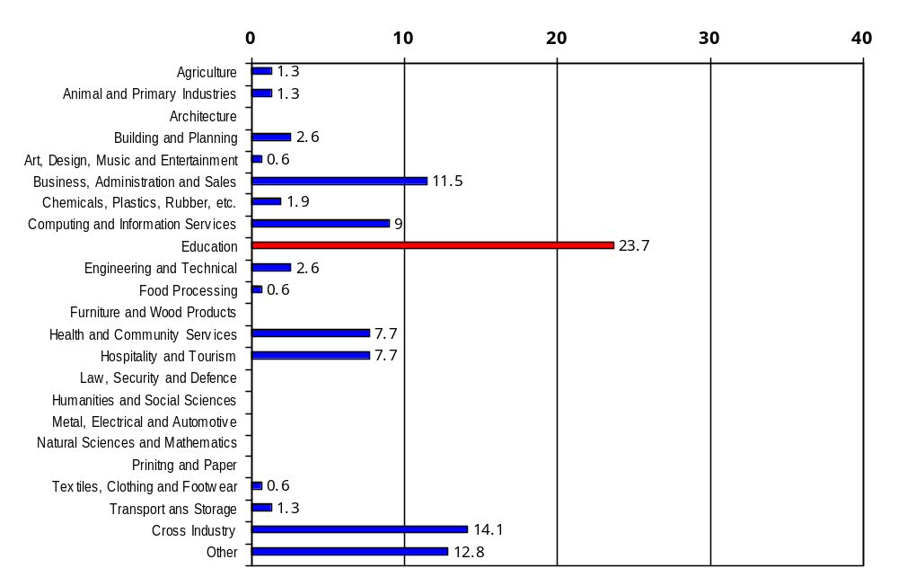
Profile Information
Q. 3: Please specify your industry area:
n=156
% respondents
Hairdressing Sport and recreation
Industrial Sciences Education Development
Educational Support Services
Resource design and development All industry areas
PD and mentoring for TAFE staff Finance/Insurance
Sport & Recreation Community Recreation
Library Business Services
Languages Horticulture
Literacy Adult Literacy
Telecommunications Finance
I work across all areas doing instructional design
While nearly ¼ of the survey participants were from the general Education area, a wide cross section of teaching areas were represented in the sample. Respondents from Cross-industry roles, the Business and Computing segments all had robust engagement with the survey.
Over 1 in 8 participants indicated ‘Other’ as their industry type, reflecting the diversity of online learning and assessment penetration. Industry types indicated included Hairdressing, Sport & Recreation, Horticulture and Finance / Insurance.
page 7

Slide 11
Profile Information
Q. 4: Please indicate the state/territory you work in?
n=158
State Response %
Victoria 44.7%
Western Australia 21.4%
New South Wales 11.3%
Queensland 5.0%
Northern Territory 5.0%
Tasmania 5.0%
South Australia 3.8%
Australian Capital Territory 1.9%
International 1.9%
All states and territories were represented in the geographic composition of the survey.
Victorian based individuals had the strongest participation rate, with over 40% of the total sample. Western Australian respondents were also significant contributors with in excess of 20% total participation.
New South Wales and Queensland were under-represented in the sample on a per capita basis.
Q. 5: Please indicate the number of staff employed (full and part time) by your organisation:
n=156
Number of Staff Response %
<25 21.2%
26-100 11.5%
101-250 9.0%
251-500 19.9%
500> 40.4%
There was polarity in the organisation size for which participants are employed.
Larger organisations were most represented (co-relating to the high participation of TAFE), followed by smaller organisations with less than 25 staff.
Overall, there was a good participation rate by organisation across the indicated employment bands.
page 8

Slide 12
Profile Information
Q. 6: Please indicate your location:
n=158
Location: Response %
Metropolitan 66.7%
Regional 25.2%
Rural 8.2%
Survey representation was skewed to participants based in Metropolitan locations.
Q. 7: What time fraction do you usually work?
n=158
Employment Status: Response %
Full Time 73.4%
Part Time (0.5 or more) 20.9%
Part Time (0.5 or less) 5.7%
The majority of respondents are full time employees of the organisations for which they work.
Part-timer’s made up just over ¼ of the sample set.
page 9

Slide 13
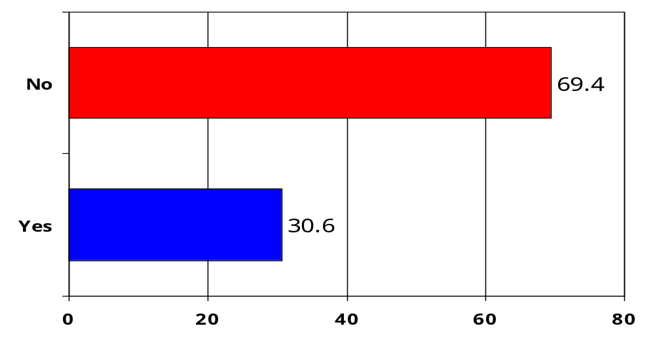
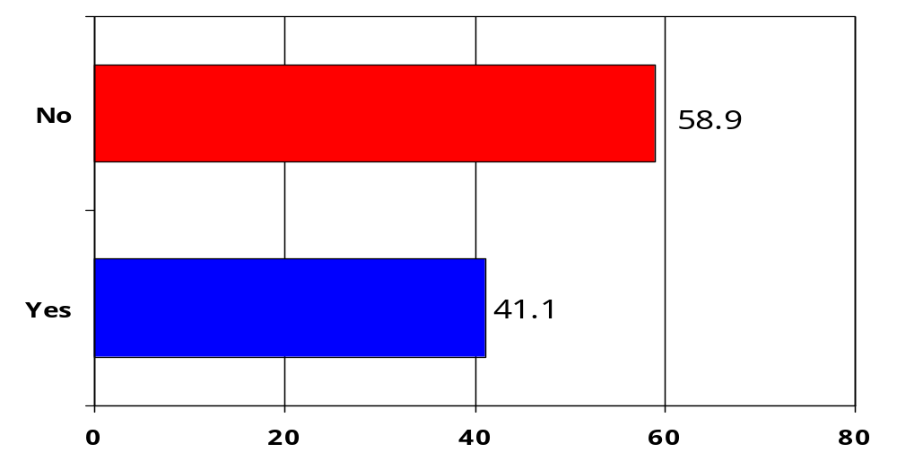
Profile Information
Q 8: Have you worked on developing a Flexible Learning Toolbox?
n=157
Nearly 70% of sample respondents indicated that they had not participated in the development of a Flexible Learning Toolbox.
The highest indicated participation rate in Toolbox development was amongst Teachers, Content Writers and Programmers.
% respondents
Q 9: Have you used Flexible Learning Toolboxes for delivery?
n=158
Over 40% of the sample indicated that they had used a Flexible Learning Toolbox for delivery.
As would be expected the Teacher / facilitator / trainer cohort had the highest participation rate, followed by Content writers / learning designers and Online project managers.
% respondents
page 10

Slide 14
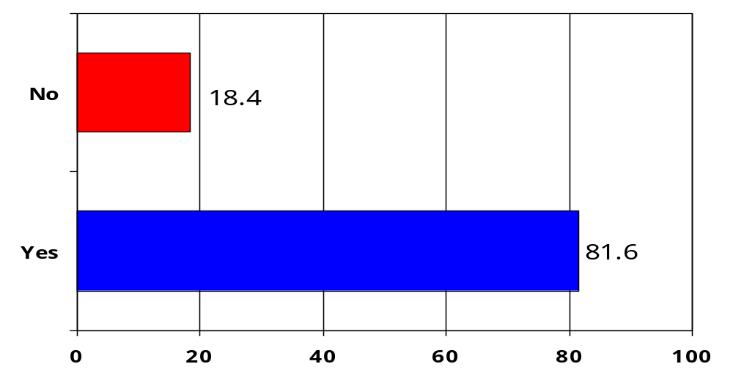
Profile Information
Q. 10: Have you been involved in delivering and/or designing competency-based training using national training packages?
n=158
% respondents
The majority of the sample set indicated that they had been involved in delivering and/or designing competency-based training using national training packages at some time.
While the Teacher / facilitator / trainer segment again had the highest participation rate, there was broad based participation amongst all positional types with the exception of Graphic designers.
page 11

Slide 15
Involvement
in
Online Learning
&
Assessment

Slide 16
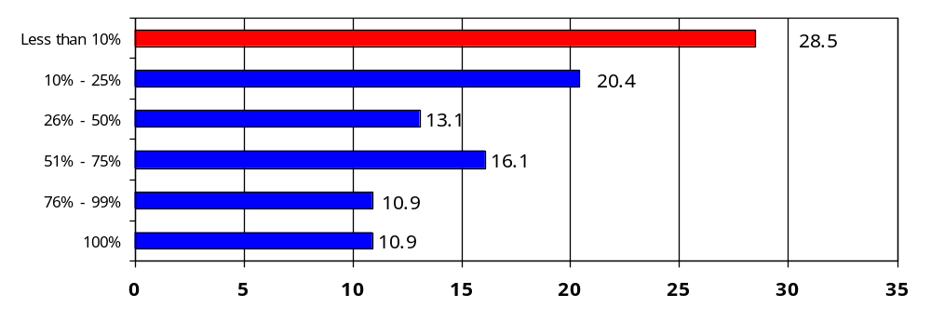
Involvement in Online Learning
Q. 1: What percentage of your current workload in VET involves online learning ?:
(any aspect – managing, teaching, etc)
n=137
% respondents
Participants current time allocation on online learning activities was mixed. Nearly 30% of respondents indicated they spent less than ten percent of their workload engaged in online learning, and over 6 in 10 of the sample spend 50% or less of their time on online learning tasks.
Those segments with the lowest involvement include Specialist Assessors, Managers and Teachers.
There was a minority of the sample who spent greater that 75% of their workload on online learning tasks, with Content writers and Programmers most likely to be engaged at this level.
page12

Slide 17
Involvement in Online Learning & Assessment
Q. 2: What types of web-based (online) learning and assessment are you involved in?
n=134
Using the web in the classroom - 14% 39% 40% 7%
using the internet with learners
Blended learning – mixture of 15% 34% 39% 12%
face-to-face and online
Fully online, facilitated learning - 38% 37% 18% 8%
distance education, supported by
teacher
Independent e-learning – online 29% 47% 20% 3%
courseware based learning
Never Sometimes Often Always
The main areas of web-based learning and assessment activities that respondents were involved in were blended learning and using the web in the class room.
Blended learning had the highest overall participation as measured by the ‘often’ and ‘always’ metrics.
Independent e-learning was used less frequently overall, while fully online, facilitated learning was the least used technique in total, with just under 40% of respondents indicating that they had ‘never’ been involved in this aspect.
page 13

Slide 18
Involvement in Online Learning & Assessment
Q. 3: There are different tasks involved in the online learning and assessment process and you could be involved in one or more of these.
Indicate which task/s you are involved in by numbering them in order of the time you spend on each task
(with 1 being the task you spend most time on).
n=127
Response Average Rank
Plan (scheduling, budgeting and managing) 3.20 3
Analyse (researching and describing) 3.57 5
Design (writing and preparing) 2.49 1
Develop (programming and producing) 3.13 2
Deliver (reaching and assessing) 3.29 4
Evaluate (reviewing) 4.23 6
Respondents indicated that the design aspect was the most time intensive component of the online learning and assessment process.
This was followed by development and planning tasks.
Less time was allocated to delivery, analysis and evaluation.
page 14

Slide 19
Involvement in Online Learning & Assessment
Q. 4: Here are some of the different ways in which people are involved in online delivery and assessment in VET. Which one best described how you work?
n=131
%
The Dream Team – member of a development team – work in a development team (eg Toolboxes),
often use high-level software tools, trained in instructional design, might not be involved in delivery. 30.5%
The Lone Ranger – teacher using existing resources – individual teacher involved at all stages of online
development and delivery, develop and use own online learning and assessment resources. 22.1%
The Collector – teacher adapting existing resources – select from and re-arrange existing online resources
(eg Toolboxes), use or customize existing learning and assessment resources and tasks 20.6%
The Deliverer – teacher using existing resources – deliver programs using existing online resources,
use assessment approach and tasks designed into the course ware 13%
Other (see next slide for other descriptions) 13.8%
Respondents had a diverse range of views about how they classified their work style and involvement in online delivery and assessment.
The most frequent work mode indicated by respondents was as part of a collaborative development team – the so called ‘Dream Team’.
There was also strong evidence of high levels of individual activity as defined by the ‘The Lone Ranger’ and ‘The Collector’.
Nearly 14% of participants indicated that their involvement did not neatly into the four defined groupings and provided a range of individual experiences in relation to their work style (see next page).
page 15

Slide 20
Involvement in Online Learning & Assessment
Q. 4: Here are some of the different ways in which people are involved in online delivery and assessment in VET. Which one best described how you work?
n=18
Other (Verbatim Responses)
Dream Team is mine but I am involved in delivery as well.
PA.
Preparation of a range of tools to assist in the self assessment of knowledge and skills of TAFE teachers.
As a freelance educator I work both in a dream team (SWP Learning Communities) and as a Lone Ranger.
Project manager write tenders/reports co-ordinate production and development by others- specialist web developers, researchers and teachers in the team.
Provide the management & administrative support for Collectors & deliverers.
As a micro RTO I often work in all or some of the roles you've described. Depends on the project.
Not delivering on-line yet.
Managing and delivering a range of blended / flexible and face to face learning support services and supporting a team of part time. sessional and permanent staff in this area.
As a workplace assessor regularly monitoring and delivering to trainees.
Do development work but largely by myself .
Allowing research using the web. Developing resources that can be used in the web environment.
The Dreamer: dreams and knows of what can be done but teachers aren't tuned in to to the online way....yet.
Development of multimedia for education. No delivery at present but that may change.
Co-ordinator facilitating online learning for teachers and students. Involved in reviewing online content and delivering some online teaching.
Administration support.
As a tutor facilitator using correspondence assessment marking with content online and assessment via email.
A mixture of the Lone Ranger and the Dream Team as am part of the development process then have responsibility for designing assessment piloting modules to external students plus evaluation.
page 16

Slide 21
Involvement in Online Learning & Assessment
Q. 5: What resources do you find useful for your tasks of managing, designing, developing or delivering online assessment? (List any specific guides, manuals, checklists, software, websites, etc).
n=100
Respondents provided a diverse and rich overview of the resources they used in their online assessment activities.
The breadth of feedback underscores the myriad sources and dynamic nature of the environment and highlights the individual approaches taken.
(Verbatim Responses)
Impart project management system ISO 9001:2000 standards and systems XML OTEN Learning Objects Analysis Database Flash MX
Basic software (Word Processor Learning Management System (WebCT) W3C guides for accessibility
W3c flexiblelearning.net.au
AMES Help Desk
Checklists website specific to the project templates for design
Tafevc site tafe frontiers ANTA learnfast ICT professional Development site various library sites PowerPoint MS word Dreamweaver Photoshop books on; organizational development Presentations and delivery developing online resources etc
Feedback from educators and students are the most useful resources. NextEd platform very useful as a resource. A teacher train module is a useful resource to get people started in training online and connect with others. Also have a design online website that is very useful for development of online education.
Learning guides manuals websites
Initially checklists but as I grow confident with the medium and environment - software Internet proformas to capture conversations activities undertaken for the learner manuals websites
ANTA web page Resource page
ICT British websites Learnscope flexible delivery manuals Macromedia software a variety of instructional design related websites.
Planning Learner Assessments http://www.thelearningmanager.com/pubdownloads/planning_learner_assessment.pdf
Writing Effective Questions http://www.thelearningmanager.com/pubdownloads/writing_effective_questions.pdf
Developing Clear Learning Objectives and Outcomes http://www.thelearningmanager.com/pubdownloads/developing_clear_learning_outcomes_and_objectives.pdf TLM (The Learning Manager) - a LMS system supporting online assessment http://www.thelearningmanager.com
To create accurate assessments I find that the best thing to do is to get the existing assessments from lecturers and modify them for online delivery. Alternatively it is always useful to actually sit in a face to face class to evaluate whats being taught and how it's being taught.
page 17

Slide 22
Involvement in Online Learning & Assessment
Q. 5: What resources do you find useful for your tasks of managing, designing, developing or delivering online assessment? (List any specific guides, manuals, checklists, software, websites, etc).
n=100
Hospitality websites i.e. Melbourne Food and Wine Festival Restaurants that show their menu Hotels with detailed information food producers etc.
ICT skills for teachers online modules & resources. TafeVC modules eg Occupational Health & Safety plus others I have developed eg Workplace Assessor Communication Hub Microsoft in Education website MS Access MS Word MS Outlook Hot Potatoes Coffee Cup HTML editor and of course Google.
Short training courses; e.g. Dreamweaver webct meetings with other developers software packages like respondus websites and free images resources checklist/manuals if detailed & well written efficient online help if links fail or changes to templates etc. aren't incorporated persistence resources facilities in webct & blackboard
Guides checklists
Surveys websites checklists manuals
Marketingteacher.com assessit.net
Macromedia Dreamweaver Flash
Assessment Generator Toolboxes Tafe Frontiers WestOne ANTA site AeShareNet PEN - Product Exchange Network (QLD) EdNa Online
Internal resources of our organisation (e.g. templates previously produced products internal learning object repository staff knowledge) Series 2 to 5 toolboxes produced by our organisation.
Training packages state curriculum browsing examples of online assessment in-house guidelines AGTF guidelines journal articles
TLM
Process chart including which team member does what in what order Examples of best practice guides
* Literature: Herrington and Oliver Harper and Hedberg * Mentoring/collaborating with colleagues doing similar work * Internal processes procedures checklists websites (instructional design accessibility) * Assessment guides (VEAC NSW) * Training Package resources and support materials
WebCT Respondus Hot Potatoes
Tafe Frontiers Toolboxes WebCT
I find that our local RTO consortium is of great help as are some of the DOT resources (these can be hard to locate though - as in not sure which one is most relevant until after some guidance).
None of these as our online learning is a thing of the future
The many free online tutorials available are an invaluable component the online resources that I have been involved in. These provide the ability to become familiar with different technologies and features as and when required.
Westone is the most useful resources but it would be wonderful to have to other places from which to access resources. On a national basis it would be useful for the education of the students of the nation if we could not only have a national curriculum in VET but also access to national resources.
page 18

Slide 23
Involvement in Online Learning & Assessment
Q. 5: What resources do you find useful for your tasks of managing, designing, developing or delivering online assessment? (List any specific guides, manuals, checklists, software, websites, etc).
n=100
WebCT Toolboxes to a limited degree ANTA Checklists and Assessment Guides Training Packages
Wise is a Queensland based company there software is very good. Smallprint is a South Australian printing company that is specialising in producing training learning materials and assessment tools. Our Auditor from TAC thought they were the best thing since sliced bread!!!!!!
Technically: Star Office + in-house XML software. Educationally : textbook on valid assessment.
Assessment Generator
Use WebCT - haven't had time to explore anything else Use internet resources for info on community services issues - provide links for students
Manuals websites Team work working with at least one other person helps to promote my creativity and we come up with innovative ideas CD
Toolboxes
Discover site and other education sites in Tasmania.
Not a lot available in the Agriculture area. TAFEVC Crown copyright courseware developed by other Institutes in earlier series are below standard. We are currently developing all our own materials using problem solving and real life case studies on a range of enterprises - dairy beef hort currently creating sheep and equine case studies.
Currently piloting WebSite Design TOOLBOX along with use of Web CT. Also in process of evaluating on-line curriculum such as Smart Force.
Veac Guides are particularly useful
Manuals checklists websites
This would take more than 10 mins to complete! Lets just say the AFL sites resources and services plus EdNa plus VLC's of many sorts.
Flexible Learning Network NCVER research
Manuals checklists
Enrolment in Graduate Certificate in Facilitating and Managing E Learning Learnscope site
Macromedia software Examples of 'best-practise' to stimulate ideas and creativity e.g. toolboxes
Toolboxes EdNA web site AFLC web Training Packages Traineeship Kits from IT ITAB Front Page NTIS website Anta website DEET web site Training.com.au Flexways website
Toolboxes W3C guidelines checklist- http://www.w3.org/TR/WCAG10/full-checklist.html
Websites software: PowerPoint hot potatoes
I work principally via my own website which I encourage student to use for research and additional info and links as well as handouts contacts etc.Will start using Web CT soon.
Crosswords worksheet generators Toolboxes WebCT
page 19

Slide 24
Involvement in Online Learning & Assessment
Q. 5: What resources do you find useful for your tasks of managing, designing, developing or delivering online assessment? (List any specific guides, manuals, checklists, software, websites, etc).
n=100
A wide range of resources specifically those we have developed ourselves for the Tasmanian elearn program both hard copy and using the web ct platform http://online.tafe.tas.edu.au/ and all these:
Background
The Challenge of the Digital Age Barbara Lepani Australian Centre for Innovation and International Competitiveness University of Sydney Lateral Solutions (Aust) Ltd http://www.oten.edu.au/qltech/lte/pdf/challdoc.pdf On Line Teaching; Where To Start? by Dale Spender Australian author of Nattering on the Net http://gos.sbc.edu/s/spender2.html
Computer Literacy & Vocabulary
http://www.adita.com/literacy.htm Do you feel confused befuddled & lost when it comes to computers? Do you wish you had the time and dollars to take a real live course on computers? Then this site is for you! http://www.jegsworks.com/Lessons/ BTR Project on Literacy and the Preparation of Future Teachers
New Literacies for New Times Discussion Board
http://www.btr.qld.edu.au/ruboard/newtimes/ruboard.htm New Media New Literacies: Challenges for the Next Century by Mark Warschauer http://www.etni.org.il/etaitalk2.html
On line and general literacy resources
http://members.aol.com/skillsworkshop/index.htm http://www.acal.edu.au/ http://www.ed.ac.uk/~calarks/arks/materials.html http://www.detya.gov.au/ty/litnet/ http://hub1.worlded.org/docs/surfing/index.htm http://novel.nifl.gov/lincs/index.html http://www.multiliteracy.com/ http://home.vicnet.net.au/~prace/beach/ http://www.aris.com.au/ http://www.virtualilc.com/ http://sunsite.anu.edu.au/language-australia/numeracy/anamol/index.htm http://www.netlingo.com/ http://www.nasa.gov/ http://www.literacynet.org/diversity/ http://www.literacyvolunteers.org/ http://litserver.literacy.upenn.edu/ncal.html http://www.alri.org/ http://www.ioe.ac.uk/library/bsa/links.htm http://www.literacyvolunteers-maricopa.org/resourcecenter1.html http://www.englishpractice.com/frames.asp?fromloc=tab_home.htm&vStyle=&v1= http://www.aris.com.au/l2l/firsttime/firsttime.htm
Email E cards and other Communication
http://home.myway.com/ http://www.emailaddresses.com/email_web.htm http://www.incredimail.com/english/splash.html http://www.e-cards.com/catalog/cat-picker.pl http://lc3.law5.hotmail.passport.com/cgi-bin/login http://www.tasmail.com/ http://www.magicpixel.com.au/ecard/ecard.html http://web.icq.com/ News http://www.news.com.au/ http://www.smh.com.au/index.html http://www.theage.com.au/ http://anulib.anu.edu.au/elibrary/news.html
page 20

Slide 25
Involvement in Online Learning & Assessment
Q. 5: What resources do you find useful for your tasks of managing, designing, developing or delivering online assessment? (List any specific guides, manuals, checklists, software, websites, etc).
n=100
Search Engines
http://www.google.com/ http://www.anzwers.com/cgi-bin/print_search.pl http://www.dogpile.com/ http://www.webwombat.com/ http://au.altavista.com/ http://categorysearch.langenberg.com/ http://www.goeureka.com.au/standard.php http://www.nla.gov.au/pathways/pthw_global.html#sear http://www.monash.com/spidap.html
Government Services
http://mc2.vicnet.net.au/ http://jobsearch.dewrsb.gov.au/ http://www.parliament.tas.gov.au/ http://www.servicetasmania.tas.gov.au/ http://www.talis.tas.gov.au:8000/ http://www.tas.gov.au/ http://www.anta.gov.au/ http://www.jobs.tas.gov.au/positions.html
General Information and sites which have been used to support students learning
http://www.freetranslation.com/ http://www.abc.net.au/default.htm http://seds.lpl.arizona.edu/nineplanets/nineplanets/nineplanets.html http://www.whitepages.com.au/wp/ http://www.odci.gov/cia/publications/factbook/index.html http://www.odci.gov/cia/publications/factbook/index.html http://www.nla.gov.au/ http://www.HowStuffWorks.com http://www.onlinelearning.net/index.html?s=221.o080o412i.093o501e40 http://www.neoplanet.com/ http://www.candystand.com/ http://www.freewarefiles.com/category/desktop.htm http://www.a2zweblinks.com/recomsites/browser/index.htm http://www.nla.gov.au/libraries/path.html
Beginners Guides
http://www.onlineseniors.net.au/tutorial/abg.html http://northernwebs.com/bc/index.html http://www.wittnn.com/english/winit/home/additionres/additionres.htm http://www.wis.sa.gov.au/ http://www.learnthenet.com/english/index.html
Latest Resources
http://www.angliss.vic.edu.au/cybermall2/ http://www.bbc.co.uk/skillswise/ http://workcover.cadre.com.au/machinery/questions.html
So far not much -most of it comes form my own head
www.ntis.gov.au researching emailing to trainees report writing including feedback monitoring changes within VET sector
TafeVC Admin Support http://www.google.com
No specific resource however access to the internet to review what others are doing locally and overseas is very important to me.
Websites checklists
TAFE VC Tafe Frontiers Resources Various Websites
TAFEVC courseware catalogue ANTA Alcohol and other drugs toolbox (II)
Toolboxes google web-ct
page 21

Slide 26
Involvement in Online Learning & Assessment
Q. 5: What resources do you find useful for your tasks of managing, designing, developing or delivering online assessment? (List any specific guides, manuals, checklists, software, websites, etc).
n=100
Dreamweaver manual Fireworks Manual
Guides checklists quizzes observation presentations
Word Firstclass Internet Spreadsheets Toolboxes Email.
National Training Packages Software: Macromedia Studio Cinema 4D Website Library resources
Fnb99 toolbox diploma in acctg webct materials
Guides software checklists
Being fairly new to my particular role anything or anyone I can source information from.
Learning Communities such as www.learnlinks.com.au wwww.learnscope.anta.gov.au and many educational websites eg www.pageturners.prace.vic.edu.au
Websites existing paper based materials software
Tafevc
The Internet Training package material: performance criteria Our library and the librarian IT staff on campus My own knowledge and community/industry contacts
Fellow staff students web content anything that will make the task easier
For managing Use Excel and our Learner Management System to track student progress Use email folders to keep track of student assessments. Designing Use different version numbers - particularly if we improve the assessment
Authorware Flash Dreamweaver Photoshop
HOT Potatoes Cam Studio Dreamweaver Photoshop http://www.flexiblelearning.net.au
The internet Html Kit
Training packages Tool Book software
Checklists screen clips very helpful the online course too manual all typed answers to questions marked and typed feedback sent via email - very time consuming
Prefer a holistic project based approach rather than a disaggregated approach. I use - industry based documents for planning & design - industry based models for project briefs and problem solving For my own online inquiry: Learnscope VLC First Monday Learning circuits E-learning Post Educational technologists come to think http://www.edtechnot.com/index.html AJET - Aust Journal Educational Technologies
Text and classroom assessment already developed. Industry sources. Latest tourism and travel websites. Continuous online pd Learnscope
Digital camera and notebook. Digital projector.
Whatever I can get access to
Manuals web site examples
Websites software and manuals
page 22

Slide 27
Involvement in Online Learning & Assessment
Q. 5: What resources do you find useful for your tasks of managing, designing, developing or delivering online assessment? (List any specific guides, manuals, checklists, software, websites, etc).
n=100
The FAME course run by TAFENSW was excellent for managing and delivery of e-learning
Flexible Learning Framework. MS PowerPoint. Toolboxes. Digital camera and video camera. Digital projector.
Past project exemplars of question types especially in the early stages to give writers an appreciation of the varieties of online questions and how they can be used effectively Writers guides to help clarity of design/writing importance of independent review etc
WebCT used for: description of course notes some assessment tasks - dropbox database of student records. Respondus for quizzes - formative self testing.
User requirements Checklists Other system like WebCT TLM etc
Research literature (often sourced from websites such as NCVER) Syllabus documentation and other paperwork from Educational Services Division.
Mainly self-generated resources
Assignment and quiz tools available in the WebCT learning management platform. ANTA draft guidelines for online course audit - it helps to know hat auditors will be looking for in designing the way records of assessment are collected and kept.
Training package and assessment guidelines of the specific course.
ANTA web site West-one web site & general internet
The flexible learning website Templates and guidelines we have developed in-house
Dreamweaver Flash
Uhm... so many! LearnScope site is a major resource flexiblelearning.net.au is another Nielsen's work on accessible web design is another... too many to list.
page 23

Slide 28
Approaches
to
Online
Assessment

Slide 29
Approaches to Online Assessment
Q. 1: How well do these statements describe your approach to assessment?
Strongly Disagree Agree Strongly
Disagree Agree
Assessment should be as close
as possible to real work situations,
especially if people are employed. 2% 2% 42% 54% n=122
Decide on assessment tasks and
then design the learning activities. 9% 34% 39% 18% n=122
Assessment of outcomes should
check that the learner’s
performance meets all the criteria. 0% 2% 64% 35% n=121
Assessment tasks should be
designed to show learners can
solve real problems by applying what 0% 0% 56% 44% n=123
they have learned.
Assessment tasks should show that
learner’s can think for themselves, find
information and create their own solutions. 1% 5% 53% 41% n=123
Assessment is checking that learners
know what’s been taught. 4% 39% 51% 6% n=121
Assessment should include tasks which
involve working with others to
complete tasks successfully. 1% 23% 63% 13% n=122
Assessment tasks should be flexible –
to suit the content and the learner’s
purpose. They should be relevant to
the learner. 0% 1% 39% 61% n=122
page 24

Slide 30
Approaches to Online Assessment
Q. 1: How well do these statements describe your approach to assessment?
In the main respondents were agreement with the thrust of the outlined approaches to assessment.
There was an overall view that assessment :
should be as close close as possible to real work situations, especially if people are employed.
of outcomes should check that the learner’s performance meets all the criteria.
tasks should be designed to show learners can solve real problems by applying what they have learned.
tasks should show that learner’s can think for themselves, find information and create their own solutions.
tasks should be flexible – to suit the content and the learner’s purpose. They should be relevant to the learner.
With regard to the statement, ‘assessment is checking that learners know what’s been taught’, 44% of respondents did not agree with this sentiment, indicating a polarity of opinions on what the core role of assessment is.
Likewise there was some disagreement in relation to the approach of ‘decide on assessment tasks and then design the learning activities’ and the position that ‘assessment should include tasks which involve working with others to complete tasks successfully’.
page 25

Slide 31
Approaches to Online Assessment
Q. 2: For which of these purposes do you use online assessment?
Never Sometimes Usually Always
To recognise prior learning 45% 48% 6% 1% n=116
To check entry level skills 32% 56% 12% 0% n=117
For self-assessment by learner 17% 41% 30% 11% n=122
To check learner’s progress
towards outcomes 17% 29% 36% 18% n=122
For accreditation 36% 33% 22% 9% n=116
The main purpose of online assessment indicated by participants was to ‘check learners progress towards outcomes’, with over 50% of respondents ‘usually’ or ‘always’ using the approach for this purpose.
‘Learner self assessment’ was another highly regarded purpose for online assessment, used ‘usually’ by 30% of the sample.
Of the various purposes, online assessment was ‘never’ used to recognise prior learning and for accreditation purposes most frequently. This may indicate that these areas are not perceived as ‘a good fit’ for online assessment, they are difficult for practitioners to implement or have not been required to date.
page 26

Slide 32
Approaches to Online Assessment
Q3: Which of these types of outcomes do you think can be assessed in the online environment?
Can be Have
assessed online assessed online
Recall of knowledge 82% n=94 63% n=63
Understanding information 81% n=95 60% n=71
Operational skills 83% n=62 40% n=30
Problem-solving 81% n=96 58% n=69
Analysing information 83% n=95 50% n=58
Synthesising information 85% n=88 43% n=44
Reflection and evaluation 83% n=90 49% n=53
Communication skills 78% n=79 56% n=57
Team skills 86% n=76 41% n=36
ICT skills 85% n=86 49% n=49
In the main, respondents thought that all of the assessment outcome options indicated could be assessed online with all metrics supported by above 75% of respondents.
In terms of participation, ‘Recall of knowledge’, ‘Understanding information’ and ‘Problem-solving’ were the outcome types most used in practice by respondents.
‘Operational skills’ showed the lowest participation rate however it should be noted that the sharply lower response rate to this metric may indicate that respondents found the option ambiguous and were not clear on its meaning.
page 27

Slide 33
Approaches to Online Assessment
Q4: Which of these strategies for collecting evidence of competence have you used in the online environment?
Never Sometimes Usually Always
Portfolios 42% 32% 22% 4% n=111
Assignments 14% 31% 43% 12% n=121
Simulations 34% 40% 25% 1% n=111
Role Plays 54% 39% 6% 1% n=108
Performance/demonstrations 43% 36% 18% 4% n=107
Tests 23% 42% 25% 11% n=103
Of the assessment options provided, respondents indicated that ‘Assignments’ were the most prevalent online method for collecting evidence of learner competence, ‘usually or always used’ by over 50% of respondents.
‘Tests’ were the next most prevalent strategy, followed by ‘Simulation's’.
‘Role Plays’ were least used to gather evidence of competence, with over 50% of the sample indicating that they had ‘never’ used the technique in the online environment. ‘Performance demonstrations’ and ‘Portfolios’ also have lower incidence of usage.
In addition, respondents provided a number of alternative and supplementary strategies for assessment and gathering evidence of competence in open feedback (see next page).
page 28

Slide 34
Approaches to Online Assessment
Q. 4a: Any other strategies you have used in the online environment?
n=31
(Verbatim Responses)
Teamwork using a bulletin board for communication and to tack progress towards goal.Developed a simulated workplace (Toolboxes)
Forum discussions/Chat room discussions.
Round robins for collaborative development/construction of a piece of work
Games
Use of third party verification Use of technical staff to assess workplace based procedures and specific software functions
Scenario based activities
Worksheets question and answers
I think it's important to stress to lecturers that you can really only test the theoretical and underpinning skills and knowledge of a course - the practical (hands on) side of VET courses is still required.
Use of downloadable workplace activities (log sheets)which are completed by the student and signed off by a supervisor. Student then keeps a copy of these sheets as evidence for a workplace assessor and also sends in a copy to their online teacher. This approach has resulted in the workplace supervisor being far more involved in the student's education as they help the student to complete the worksheet and sign off on it.
Group work can be added to any of these strategies. This may be covered in 'performances/ demonstrations' - using a log book signed by workplace assessor/supervisor
Scenario/case study analysis projects that simulate work order/requests
Case study analysis and reporting problem solving applying legislation and human rights reflections on personal and professional values
Task completion where a student plans a series of smaller tasks that lead to completing the whole.
Discussion Group exchanges Reflections chat sessions all contribute to final assessment.
We have found that a combination of the online environment and direct observation and face to face assessment strategies using a variety of tools by a third party or online teacher where possible at the learners end makes for a more valid and reliable assessment outcome.
Discussions that involve decision making discussions that lead to development of assessment tasks.
Networking in order to produce specified outcomes students planning and co-ordinating face to face presentations.
Videos
I have only developed online learning tools for assisting students learning a program. I am hoping to use Hot Potatoes soon for assessing.
No just quizzes and testing
Poor questioning techniques leads to lengthy answers and becomes very confusing for online students.
Group assignments on a shared web space
Technical drawing line by line.
page 29

Slide 35
Approaches to Online Assessment
Q. 4a: Any other strategies you have used in the online environment?
n=31
Discussion activities
Online facilitation to enure group interaction and dynamics are a key focus on the students learning. Have discussions that are very focuses and meaningful to willingly involve participants and enable the most effective learning of all taking into account the various learning styles.
Community building and peer assessment
Analysing their participation in email discussions forums and chats
Case studies built over time
Testing / Observation for: Ability to follow written and oral instructions Understanding the language / terminology Ability to read / understand a web page Being aware of security and privacy issues / tools / options. Ability to use tools like online forms calculators etc Ability to access and use functional literacy tasks like shopping banking etc Navigational / search skills to find information. Reading and understanding and evaluating information. Ability to use / save / print / present information found on the web.
Some collective work involving teams and team building - particularly contributions to chat rooms and bulletin boards.
page 30

Slide 36
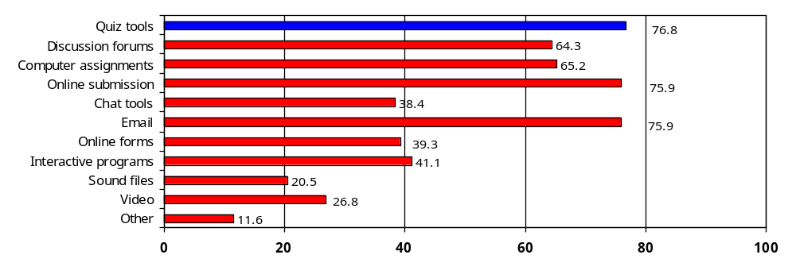
Approaches to Online Assessment
Q. 5: Which of these online tools do you use for assessment?
n=112
% respondents
Verbatim Responses
Simulated instruments
Online games
I primarily only use online based assessment for formative assessment. For summative assessment I prefer not to use online assessment only
Digital images
Downloadable templates and worksheets
NB Re Points 4 & 6: As online designers we don't specify whether an assignment will be submitted online - however we design to allow for this if teachers wish to accept online or email submission.
These coupled with direct observation where possible.
All the above is past tense.
Presenting results of online skills searches etc in MSWord file or presentation program or as paper-based document.
Interactive multimedia files (Flash)
I am hoping to use Hot Potatoes soon for assessing.
Html versions of PowerPoint's
Online project groups
Quiz tools, email and online submissions are the most frequently used assessment tools with in excess of 75% of respondents utilising these techniques. Computer assignments and Discussion forums are in broad based use for online assessment.
Multi-media approaches such as video and sound files have less current penetration. A range of ‘alternative strategies were presented in open feedback.
page 37

Slide 37
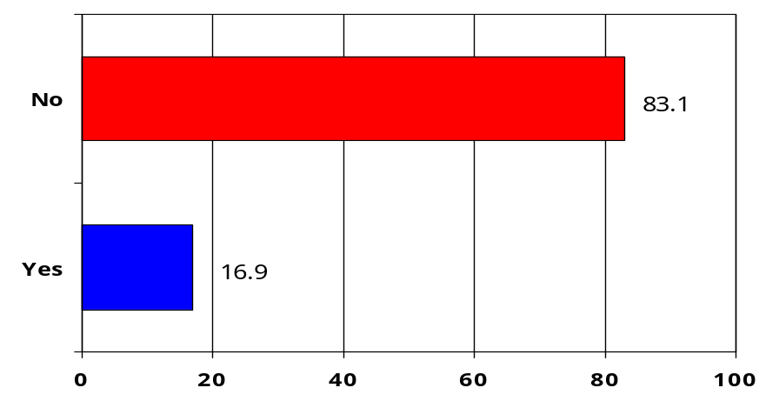
Approaches to Online Assessment
Q. 6: Do you use strategies to assess group performance online?
n=118
Group performance assessment is not in common usage amongst practitioners in the sample set.
Less than 20% of respondents undertake online group performance assessment. As would be expected the highest usage of this technique is amongst Teacher / facilitator / trainers.
A variety of implementation approaches are described in the open feedback.
% respondents
How ? (Verbatim Responses)
Mainly observation of group performance combined with reflection and/or evaluation from participants against specific objectives.
Forum discussion of problem solving exercise
Combined Assessment
Tracking facility within webct
Task set within a discussion forum. Students distribute sub tasks complete assignment and report back to others online. Peer assessment of participation in the group task.
Students undertake team projects; each has to justify/describe what they did; each notes the main area foe which they had responsibility; a telephone conversation tape or video recording may be requested from student.
Discuss the expected outcomes with the group via email and facilitate and how assessment will be measured from the group contributions
Integrated projects
forum discussions responses to information group projects
Small group assignments
Reflective journals Group assignments
Forums and chats
I ask the students to present an individual participation log which details how many times they have participated in the activity and what roles they played. Sometimes I compile a checklist which they have to fill out and be prepared to discuss with me.
Discussion board and private mail
Group work - team based assessment
Group discussion on particular topics
Online project groups and group reporting
Interactive forums - responses to other learners are required as well as participation in learning how to teach online
Depending on the task the teacher is party to all communication in the group including email forum and chat room. They monitor the quality/quantity of communication and intervene with individuals if necessary.
page 32

Slide 38

Approaches to Online Assessment
Q. 7: Do you use peer-assessment?
n=119
According to respondents peer-assessment is not widely undertaken.
Some useful insight into the various approaches adopted by participants who do use peer-assessment is outlined in the open feedback.
% respondents
How ? (Verbatim Responses)
Informally not as part of competency-based assessment. I've used learners as assessors - ie giving each other feedback on work.
Students can pair up with a study buddy and provide formative assessment (feedback) on each others work according to criteria provided in the materials.
The employer confirms task being undertaken.
Most of the time when creating peer-assessment we ask students to post their tasks to the discussion boards and discuss/comment on each others work.
Supervisor.
Student is generally part of a working team in a hospitality/tourism establishment. Encouraged to use what they are learning at work with peers.
Mostly used with discussion forums (eg 'Post your ideas to the forum; choose another student who has ideas that differ from yours and respond ....'); this is used for formative assessment not summative.
Students evaluate the efforts of team mates when working on projects.
Checklists and written and verbal feedback.
In group work regarding task completion and individual assessments of work and different ways of completing work if the chance arose again( what would you do differently?).
Open review/critiques of work done -discussion exchanges.
We have had some group discussions pitched like a competition with prizes for the best group.
through group presentations.
Contribution to Virtual Communities Participation monitoring and feedback.
Rpl-360 degree assessment.
Paper-based self-assessment sheets for online skills required. Diary notes in Work Diaries.
Group discussion and evaluation of subject material
Evaluation sheets filled in by peers to assess performance.
Critiques on particular solutions.
page 33

Slide 39
Issues
&
Benefits
of
Online
Assessment

Slide 40
Issues & Benefits
Q. 1: Following are some problems people have reported with assessing online? How do they rate in your experience?
Strongly Disagree Agree Strongly
Disagree Agree
Takes a lot of time 3% 39% 49% 9% n=118
You can’t assess real competence
(performance) 5% 55% 34% 7% n=119
Problem of security – you can’t be
sure who completed the task 5% 32% 48% 15% n=121
Meeting accessibility standards is
difficult and time consuming 0% 29% 62% 9% n=113
The biggest issue being encountered with online assessment by practitioners is the time and effort required to meet accessibility standards. Over 70% of respondents ‘agree’ or ‘strongly agree’ that this aspect is a problem in their experience. Positive identification of learners in relation to the security of compliance and the overall amount of time required to undertake online assessment are other underlying problems reported.
While sixty percent of respondents did not agree that ‘real competence’ could not be assessed online, there was a polarity of opinions on this issue.
page 34

Slide 41
Issues & Benefits
Q. 1a: Please describe any other problems that you have experienced in undertaking online assessment:
n=49
Participants cited a number of issues and barriers that they have found problematic in undertaking online assessment.
These include practitioner skill sets, learner access and familiarity, technology impacts and resources.
Verbatim Responses
Developing online assessment involves highly specialised skills and knowledge.
While i generally agree with the above statements it does depend on the task that is being assessed. A physical task such as build a wall can not be assessed online alone. However something such as use the internet to research information may be possible to complete online.
When assessing older workers who are not used to computers they shy away from this method
Easy to assess knowledge of facts harder to assess ability to research synthesis problem solve nearly impossible to assess practical skills. The virtual workplace only provides examples and work based problems- still need to undertake face to face assessment where learner demonstrates practical skill.
Getting them to complete on time
There is sometimes reluctance by assesses to undertake online assessment. Online assessment can lead to a more prescriptive approach to assessment ie if set questioning becomes available it follows that it will become more expected to use those questions. This take away the principle that assessors are responsible for identifying the type and quantity and quality of evidence.
Access to the platform for course set-up administration positing content etc
If learners are being asked to draw on the experiences of their workplace you have to ensure you are familiar with that workplace and the scenarios that may occur and or the context of the workplace. Alternatively you need to set up agreements with assessment witnesses who do understand the workplace and can comment on the accuracy and or ability of the learner in the workplace situation
Often we've encountered problems with infrastructure and logins. This is very common... setting up logins for quizzes or online tests can be time consuming and students stress out if they cant get in at designated times.
Major problem is still student's ability to access & use technology. The steps required to submit an assignment can defeat some students. The time it takes to download a file to assess can also be a problem for me given that I work from my home computer to do this.
Student resistance if early experience is poor; logging on links not working too much onscreen text emails not arriving etc student printing costs for hard copies.
Student unfamiliar with the delivery platform Large files
Negative attitude to use of computers or online technology not linked to particular problems with online assessment. Teachers need to be able to change the assessments - this is not always easy to set up.
page 35

Slide 42
Issues & Benefits
Q. 1a: Please describe any other problems that you have experienced in undertaking online assessment:
Verbatim Responses
Security is an issue but there are ways of checking that a student has really done the work -especially if assessment is progressive .... Ie
students are asked to submit work review it (perhaps with peer review) then improve on it and re-submit.
As in all flexible delivery getting assessment tasks at any time is difficult to manage. Keeping track of a student's progressive work when there is a big gap is a problem. Also keeping in mind the criteria for each individual task can be challenging
Printing out work - competency assessment is difficult when there is no demonstration of tasks. Time consuming in that not all work comes in at once and students expect a prompt response (even when they are overdue with work).
Accessibility CAN BE difficult (the question above didn't have an option for both agree and disagree depending on circumstances). my biggest problems are security and assessing practical skills with the level of technology available to client groups.(ie the technology can do it we just don't have access at the moment).
Participants assume that online training will be easier than attending physical courses in actual fact it can be a job in its self keeping people motivated.
Online assessment tools provided within the courses accessed can be out of date and not match the current software in which the student is working.
The technology infrastructure available to teachers and students do not always make assessment easy. Limitations on bandwidth and age of computer systems can be major problems.
My industry requires alot of people contact and communication skills and I still have problems assessing that mechanically as this often needs the visual to join with the process.
Summative assessment is a problem - recording marks checking identity - have not used this online. Accessibility is a big problem the first time a technique is used and there usually remain questions about just how accessible one has managed to make the product. Some of the w3c accessibility rules should be relaxed for the ed sector (eg scripts). Use of scripts can *enhance* accessibility but this is not often done as one has to make it all work without scripts.
The reformatting of existing assessment tools to be able to be deployed in either online or print format so that students aren't disadvantaged.
Lack of time and resources to create meaningful online assessment
Rural ICT infrastructure limitations means we always supply online students with print and CD ROM copies of all content.
File size issues for large multimedia files.
Software platforms can be difficult to use - but they're getting better all the time. For small RTO's expense is another issue but more freeware and peer to peer communication tools are becoming available.
page 36

Slide 43
Issues & Benefits
Q. 1a: Please describe any other problems that you have experienced in undertaking online assessment:
Verbatim Responses
A challenge is for teachers to accept that security problems can occur in any situation where you are not physically observing assessment. A range of strategies ensures this does not occur too often.
Technical issues - information sent by students lost in cyberspace!
The problem of extensions. Funding constraints necessitate end dates and people don't always complete the work within the time frame provided.
Personal past experience has only been positive although limited
Technology / submission problems. In most cases these sorts of issues can be solved but often take some time in the solving/chasing up
Being located in the country some issues have revolved around access to up to date computers with good internet connections.
Computer crashed during assessment
Technical probs
Technology mainly - incompatible programs varying levels of techno ability no broadband so can be time-consuming. Have to design / make my own assessments as online learning new in field of Adult Literacy. Language difficulties pace of learning and individual learner needs not considered a lot when discussing VET assess and learning options. Attention needs to be paid to how base learners start their pathways in TAFE by learning online skills to be able to study online courses in beneficial and suitable learning environments - a key area for those involved in Adult Literacy provision and Tutorial Support as well as for ESL learners.
Unstable nature of WebCT/TAFE VC server.
The different levels of ability in relation to using computers. Getting past the I'm no good with computers mentality. Student access to computers. Computers that aren't working. Access to enough computers on campus when I am conducting face to face workshops. Team work where students don't participate or students who do NOT SAVE THEIR INDIVIDUAL WORK and hand over an entire project to a student who does not do what he’she is supposed to do in relation to the project e.g. having it ready in time losing discs etc.
Initial participation by those concerned
Have not yet tried
Static in nature and unless the developer or company has a large amount of web development experience then it can be boring and complicated for the user.
Poorly constructed assessment questions very broad open questions leads to confusion as to what is asked? Too many students to manage in allocated time. e.g. 300 online to (1) tutor. leads to significant drop out rate. Not being able to update the students learning content online. Out of date links text references etc.
No time to design & produce resources
You have to take that the person who fills out the assessment is the person who is doing the course
Little indication of how many attempts were made to complete the task.
The unreliability of the power grid in the NT wet season.
Misunderstanding of the task requiring more information/guidelines incorporated into the task.
page 37

Slide 44
Issues & Benefits
Q. 2: Here are some reported benefits the online environment offers for assessment in VET. How do they rate in your experience?
Strongly Disagree Agree Strongly
Disagree Agree
More flexibility for learner 1% 7% 66% 26% n=121
Good for ongoing continuous
assessment 0% 4% 76% 20% n=114
Saves teacher time by tracking
and reporting results 2% 24% 57% 18% n=118
Helps meet reporting requirements
(student data) 0% 10% 70% 20% n=115
Offers engaging new options for
Assessment (simulations, role play) 1% 8% 64% 26% n=118
Engages younger learners 1% 15% 68% 17% n=114
Enables you to build and assess
communication and collaborations skills 0% 23% 64% 13% n=114
Most respondents agreed with the stated benefits provided by undertaking assessment in the online environment.
The most pervasive beneficial outcome was that online assessment was ‘Good for ongoing continuous assessment’ and the strong view that online assessment ‘Helps meet reporting requirements’.
There was less agreement with the statement ‘Saes teacher time by tracking and reporting results’, reinforcing prior responses as to the perceived time requirement needed to undertake online assessment.
There was some disagreement regarding the ability of online assessment to ‘build and assess communication and collaboration skills’ and its engagement of younger learners.
page 38

Slide 45
Issues & Benefits
Q. 2a: Please describe any other benefits that you have experienced in undertaking online assessment:
n=34
Participants were able to share a number of other benefits derived from online assessment based on personal experience.
Some observations include greater access, enhanced flexibility, convenience of submission for learners and greater opportunity for collaborative learning.
Verbatim Responses
Students found it easy and quick to submit assessment items online (I was teaching Basic computer ops) from home or an online access centre. Assessment items could be marked at any time and returned quickly to student without using any paper. Also automatic recording of activity and communication between student/teacher. Students had assessment instructions readily available at any time from the online course.
More flexibility for the teacher! Opens up the global market - fantastic for multicultural groups of learners from all over the world.
Puts some fun element in the competency measurement
Provides the learner with an opportunity to reflect on the work and skills they are undertaking daily and gain a deeper understanding of how various internal and external factors can impact on their work role
Gives you more options for assessment and allows you time for assessment.
Fundamentally it saves me time. Assignments submitted via regular email as an attachment mean that I don't need to have final student work submitted post last face-to-face session mailed to me or make special arrangements to collect them. I can respond via email - a student has my comments quickly - again without making extra trips to receive them. This also relates to assignments submitted via Tafevc with the added dimension of security and consolidation of results in the one area.
Provides an additional option for independent learning with unexpected timetable changes absences and flexible learning in longer period sessions
Remote students have the opportunity to participate
The ability to build a collaborative community has been the best experience for me. This is a challenging thing to build into the assessment however.
Just quicker access for those who previously relied on distance education.
Online assessment provides an excellent opportunity to assess a candidate’s theoretical knowledge prior to participation in a practical assessment.
Less storage and easily obtainable records when needed.
Leveraging from existing assignment items and assisting teachers in marking process (with well-designed online marking guides)
It has been an experimental thing for me and I have learned new skills as a result. Everything is still very much in the experimental/formative stage for me.
page 39

Slide 46
Issues & Benefits
Q. 2a: Please describe any other benefits that you have experienced in undertaking online assessment:
Verbatim Responses
Gives the learner more control. Reduces the risk of cultural bias of the assessor.
Engages off campus learners and helps overcome the tyranny of distance.
Consistency Reusability Time saving for developing more interesting and current resources.
It enables people in rural and isolated areas to participate fully in nationally accredited training and have their competence confirmed.
Submission of assignments - can give you a definite record and time/date stamp of when the work was submitted. Drafts of assignments too can be easy to post send to tutors/teachers suggestions added by the teacher and passed back to the students. Electronic store of assignments too can reduce the chances of assignments being lost Draft assignments can be posted easily for peer review before final submission.
Much easier to keep copies of students work and is also easier to highlight any plagiarism or collusion as the layout is the same for all.
Accessible to a wider region of students.
Inspired and Innovative learners adapting content.
Flexible solution for part time students or those working full time e.g. wishing to access results online. Reduces human error (if system is foolproof).
Creativity.
It not only develops students skills in their area of study but increases their ICT skills.
It has made me very focused in terms of what constitutes adequate assessment and what kinds of assessment are most suitable for on-line. It is actually one of my favourite activities in my job.
The 'pooling' and discussion of peer knowledge.
Learners progress faster than in traditional modes of delivery (generally). Student satisfaction is high as feedback is immediate. Marking process is transparent. Students with difficulties are identified sooner.
Chance to keep up with latest developments in learning.
To build assess comms needs the time allocated to the facilitators.
Works best blended with face-to-face the interaction between the two benefits both modes.
Collaborative learning wherein someone discovers a link and passes on the info to form a chain reaction among other learners.
Greater student interest and participation.
page 40

Slide 47
Issues & Benefits
Q 3: Do you have any other comments, issues or suggestion about online assessment?
n=66
Over 40% of participants provided further feedback regarding their insights into the current state and future opportunities relating to online assessment.
The deep commentary provided by respondents underlines the interest in the area and the willingness of practitioners to share their input to enhance the overall body of knowledge.
Verbatim Responses
Always focus on the needs of your learners
Think ahead plan how you will ensure the student has good preparation for assessment (ie in acquiring the knowledge and skill in the competency) Think about workplace relevance of the assessment tasks combine elements and competencies into relevant assessment tasks.
Make the assessments relevant not only to the topic but to what the individual will actually be doing in the workplace.
Be Patient. Remember it is only a machine!
Insert chips into students behind ear to ensure validity of assessments or just give up worrying.
Think like a learner make it challenging and stimulating but ALWAYS relevant and real.
Specify clearly to students at the start of the course the task and the criteria that they will be assessed against. And the medium (email chat or bulletin board) that will be used.
The three Ls of online assessment - learner learner learner. Always always keep the learner in mind. Look at the assessment tool from their perspective and cater for as many potentialities as possible including IT skills literacy levels and even physical capabilities.
Try to remember that students have different learning styles (eg: active/reflective sensing/intuitive visual/verbal and sequential/global)and warn them that you will use a number of these styles not only to accommodate individuals who match that style but also to get other used to dealing with learning styles that might not suit them. THEN REFLECT THIS IN YOUR ASSESSMENT METHODS.
Assess online and reduce your administration! Assess online and move the choice to the learner! Assess online and add fun to your blended learning environment! Assess online and join the new wave of assessors!
Online assessment is not about the expectations but the varied perspectives.
Give lots of feedback that encourages the continuation of the learning experience in a way that builds on what they already know. People needs lots of encouragement.
Recognise that not all is better online
Plan
page 41

Slide 48
Issues & Benefits
Q 3: Do you have any other comments, issues or suggestion about online assessment?
Verbatim Responses
Spread assessment through the online resource material so there is a building of assessment evidence and allows the teacher to gauge the skills and understandings of the learner (building in authenticity and clear/consistent authorship). Then to follow this up with defined summative tasks to round out the assessment including tasks that consider the practical component of the assessment.
Offer different ways of assessment...I think find a balance.
Be careful of the traditional true/false etc they only test surface learning. We need to try to use assessments that are more scenario based use game playing and which engage learners in deeper learning. This is the challenge.
It must be seen in context of what the competency is and how this provides evidence to the trainer.
Be flexible but set guidelines.
To be successful I think it needs a combination of online evidence and face to face interaction to verify the evidence.
If possible before your students start an online assessment set up a 'practise' assessment with dummy questions in it to give students the opportunity to get used to the online format and have a go. This should give them more confidence when they take the real online assessment and allows them to focus on what they have to learn for the assessment rather than how they have to answer the questions what buttons they need to press and how long they have to do it in.
Ensure that the online material contains accurate voice over if used. Often the voice paraphrases the script instead of speaking it exactly. Very confusing for some international students.
Music as you assess! Try Bizet's Carmen to motivate or a Cat Steven's CD to enhance the assessment process.
Start small keep abreast of latest software/hardware return to new developing courses regularly to retain efficiency in use of the software and have good access to competent expert help; (unless you are an IT instructor) OH! and persistence!
Stay in touch with your students as much as possible. Respond to their queries promptly - just to let them know there is someone looking out for them.
Online assessment should be easy to do - the technical aspects should not over ride the shill/competency being assesses. You know you have it wrong when the students are obsessing over the how to rather than the what of the assessment.
Make your online assessments easy to use and flexible to submit. Put yourself in a student's position and give as many practical submission options as you can. e.g email attachment online submission hard copy fax or post.
Where appropriate give the learner the option to undertake an assessment event either in their workplace or in a simulated 'workplace' online.
If you don't consider yourself a student with a whole lot to learn don't try to be a teacher!
page 42

Slide 49
Issues & Benefits
Q 3: Do you have any other comments, issues or suggestion about online assessment?
Verbatim Responses
Where appropriate give the learner the option to undertake an assessment event either in their workplace or in a simulated 'workplace' online.
Start with sound assessment planning: 'How are we going to help learners gather the evidence they require to prove they are competent?' Then use the technology to provide your target learners with the most effective and rewarding assessment experience possible.
You need to do lots of planning and careful development. But more than anything you need to be able to jump in the deep end try out strategies and try again next time after refining what you are doing.
Constantly review and change as your client base change. Talk to people working with similar constraints.
Be fair. Remember some people may not be experienced in computers and will be learning A LOT as well as conquering nerves.
Consider whether an online assessment is truly the appropriate way to gather valid evidence or is it better to use technology as a means of guiding the leaner through the assessment process.
Assess online for the learners of the future.
Provide clear guidelines of what is expected. Make it as interactive as possible. Enable the progress to be reported during the assessment is the student desires it. Seek feedback from students on the assessment process and take note of that feedback and improve the assessments where you can.
Make it people friendly that is have a user help develop it not a programmer only!
* Assessment is a GOOD THING! * Quantity is no substitute for quality but quantity helps. * Drill and practice is not dead (although some would wish it dead!) * Advanced techniques like simulation are ideal but MUCH more expensive to develop. * Use the communication tools for ongoing assessment (but don't over-use them or trivialise them). * eg Forums could be used for assessment but this should be a small % of the total use and very clearly distinguished - its more important to use the comms tools to replace the interaction loss of face to face.
Needs to be user friendly - if the teachers don't like it or find it difficult they will avoid it. I've also found you need to Sell the benefits
Make the activity engaging and use a problem solving approach - an approach that doesn't lose validity because students find their answers on the www or other sources. An approach that does not see collaboration and research for answers as CHEATING!
Make it real. Include problem solving and contingency plans.
Make sure that learners understand what they will be assessed on and how they will be assessed before the teaching/learning process begins.
Making sure everyone knows where we are going and they believe that the greatest benefits will be accrued by the individual they will each be better.
page 43

Slide 50
Issues & Benefits
Q 3: Do you have any other comments, issues or suggestion about online assessment?
Verbatim Responses
Make it real. Include problem solving and contingency plans.
Clear instructions.
Make the assessment engaging and tailored to the student.
Word very carefully to avoid ambiguity
Be flexible to individual learning styles. Encourage learners to take an active role in formulating their assessment.
Have a range of assessment styles per outcome for older learners as they have a very ingrained learning style which they need lots of support with adapting. (They come from a ROTE system of being taught at not an interactive collaborative style based on their needs)
Use KISS when developing instructions
Remember the human behind the computer screen and plan assess and feedback accordingly!
Keep it simple make it fun have some face to face interaction/activities too.
The key to learning is flexibility and so remember you may have to have another option!
Make assessment tools that are varied interesting and provide informative feedback. They should challenge the learner to investigate and problem solve - not just true/false or multiple choice type problems. Should involve leaving the online environment at times.
Plan listen to your learners revise test!
Make sure its part of the whole assessment process
Treasure Hunt - individual or pair - searching sites for information to answer questions.
The best way to ensure that that assessments are valid and reliable is to involve some face to face support and assessment at the learners end where possible. Where this is possible we have experienced far better outcomes for the learners.
Tell the students the involvement is assessable!
To be implemented as a part of the initial sign up with trainees and employers. Using on-line assessment is a part of competencies for many packages especially Business Services Provides prompt and timely feedback Creates opportunity for assessors to free themselves for more trainees.
Make it accessible flexible and responsive.
In the classroom teachers interact with all learners no matter how well they are progressing. Just because an online learner is moving through a course at a rapid rate and does not appear to be having any difficulty they are no different. Maintain communications with all online learners regularly to ensure they feel part of the learning community. They are part of the 'online classroom' and should be treated as such.
page 44

Slide 51
Issues & Benefits
Q 3: Do you have any other comments, issues or suggestion about online assessment?
Verbatim Responses
I believe that by using online assessment we are providing the students with a much more flexible method of delivery allowing for issues such as distance and location as well as more flexibility in entry and exit points within modules. It is fantastic!
The assessment activities need to be small and well spaced. They should also be fun.
Always have a plan B in case things go wrong.
Strong foundations and open access.
Don't throw the human support out with the technology ie ensure plenty of people are available for technical and content support: facilitator other students techo.
Make the system as easy error-free and user friendly as possible. It may take more time and expense but it's worth it in the end.
good content that relates to work environment
Personalise your relationship with your online students by organising visits or an induction. Let your students know that just because they can't see you doesn't mean that you can't still be available to assist them. Make sure your students feel comfortable using the technology first!
Make sure students are thoroughly familiar and comfortable with the technology and the processes used in the program or type of assessment you are using so that technical and other user difficulties do not hamper the real outcomes of the online assessment. Care particularly needs to be taken with students new to online learning environments.
Plan well in advance what you hope to achieve and don't be too ambitious - keep it relevant simple and interesting.
Make it fun. Make sure it reflects the performance outcomes for the competency. Make sure the students know what they have to do and that they have the skills to do it. The assessment task should be specifically designed for the on-line environment.
Make the subject relevant make the subject real life make sure feedback is given quickly and is relevant. (online learning is after all about What They Want When They Want It) don't turn the student off for their next online experience
Have realistic expectations-online assessment is a tool and provides another option-think carefully about it's use-ensure it is relevant and not just a gimmick’
Clear concise assessments which reflect the knowledge of outcomes
Although it can be time consuming when you first begin you do develop a routine and it becomes easier. Don't be frightened and be prepared to give it a go!
Relevant exciting materials.
Make sure its intuitive
Make it interactive but not overwhelming.
page 45

Slide 52
Issues & Benefits
Q 3: Do you have any other comments, issues or suggestion about online assessment?
Verbatim Responses
There is nothing worse than facing pages of boring text - interaction holistic learning creates interest and promotes development
Good instructional design to build course upon. Fast response to student's questions involve students in collaborative learning. well thought out questioning keep manual Q & A to a bare minimum.
Its about the learning outcome not the technology.
Give online assessment a go - try it out
Independent learning - building the assignment so that the students are partly involved in the design process of their assessable work
Approach each student enthusiastically. Let them know you are keen to provide support. Look forward to their assignments. Congratulate students on their results and encourage them to continue.
Have a lot of time to allow you time to help students who have trouble with technology
Be as realistic as possible while maintaining the speed of delivery. Anyone above twelve years of age expects real people in the demonstration; Animations and cartoons are for kids and people who haven't quite grown up.
Make it relevant to the workplace
Measure the learning outcomes - the old validity and reliability has never gone out of date - it is the way you adapt to learner and teacher's needs rather than the method you use.
Flat file structure is the way to go for new users to navigate easily. When printing a document or page give the student some indication that the print job is sending or sent as multiple document prints and printer back loads in a group situation are commonplace.
Select the most appropriate type of assessment tool for the particular competency and where possible allow for a variety of evidence in support of the competency.
Probably most successful in a blended delivery mode and as a formative and self test tool combining a teacher's knowledge of a student and and their work with the flexibility the online environment provides.
Play around with ideas and fine tune them once you have trialed them on students. The options are endless!
page 46

